Slide 1
Using Service Principal with Power BI embedding
Ted Pattison
Principle Program Manager
Power BI Customer Advisory Team (CAT)

Slide 2
Choosing the Correct Embedding Model
User-Owns-Data Embedding
All users require a Power BI license
Useful in corporate environments
App authenticates as current user
Your code runs with user’s permissions
User’s access token passed to browser
App-Owns-Data Embedding
No users require Power BI license
Useful in commercial applications
App authenticates with app-only identity
Your code runs with admin permissions
Embed token passed to browser
User-Owns-Data Embedding for use within Organization
App-Owns-Data Embedding for use by ISVs
Browser
Power BI Service
Browser
Power BI Service
iFrame
iFrame
Azure AD
Access Token
Power BI
Embed Token

Slide 3
User APIs versus Admin APIs
Power BI User APIs (e.g. GetGroupsAsync)
provides users with access to personal workspace
provides users with access to app workspaces
provides service principal (SP) with access to app workspaces
Power BI Admin APIs (e.g. GetGroupsAsAdminAsync)
provides users with tenant-level access to all workspaces
does not currently support app-only authentication
Public preview for read-only access to admin API for Service principal comes in Dec 2020

Slide 4
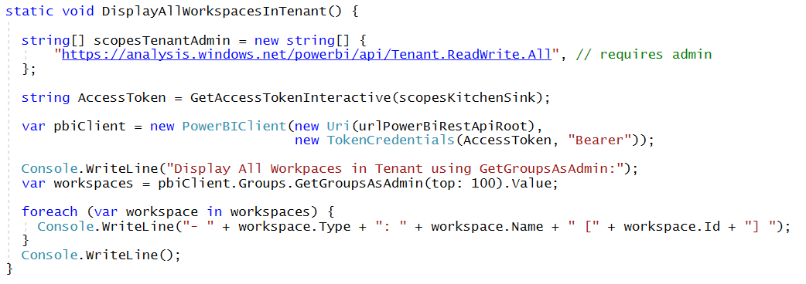
Calling into the Power BI Admin API
Admin API exposed using AsAdmin methods
Example:
Makes it possible to access every workspace in current tenant
Requires access token for user who is tenant or Power BI admin
Not supported when calling as service principal with app-only token

Slide 5
App-only Access Control
Service Principal used to configure access control
Requires the use of v2 app workspaces
Service principal must be added to app workspaces as admin or member
Access control NOT based on Azure AD permissions
App Workspace 1
Admins
User 1
User 2
App 1 Service Principal
Power BI Service
App 1 Service Principal
App-only Access Token
App Workspace 2
Admins
User 1
App 1 Service Principal
App 2 Service Principal

Slide 6
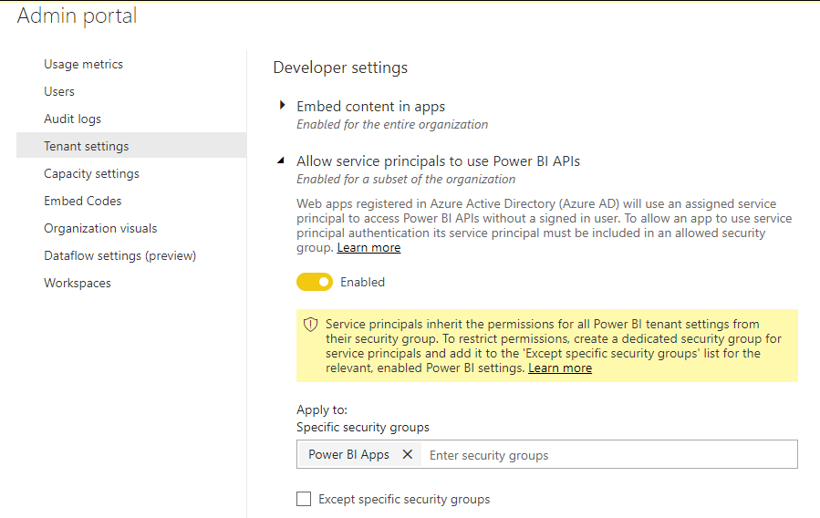
Tenant Setup
Your Power BI Tenant
These serviced principals now have access to the User APIs
Power BI Enabled
Service Principals
Service Principal
Application 1
Security Group
Power BI Apps
Service Principal
Application 2
Service Principal
Application 3

Slide 7
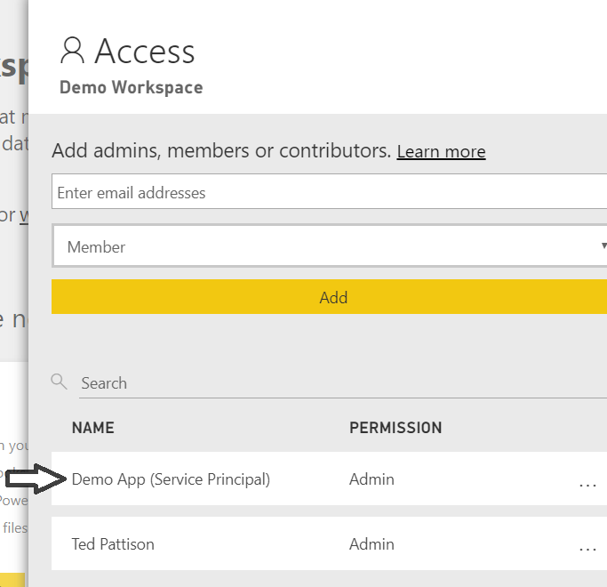
App-only Access with PBI Service API
Service Principal added to workspace as admin
Only works with v2 app workspaces
Provides full workspace access to service principal
App Workspace 1
Admins
User 1
User 2
App 1 Service Principal
App Workspace 2
Admins
User 1
App 1 Service Principal
App 2 Service Principal

Slide 8
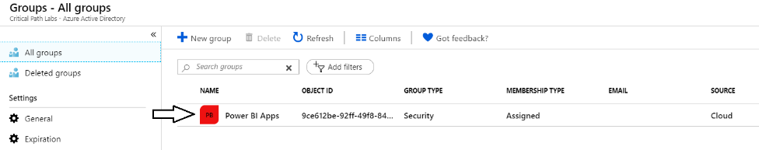
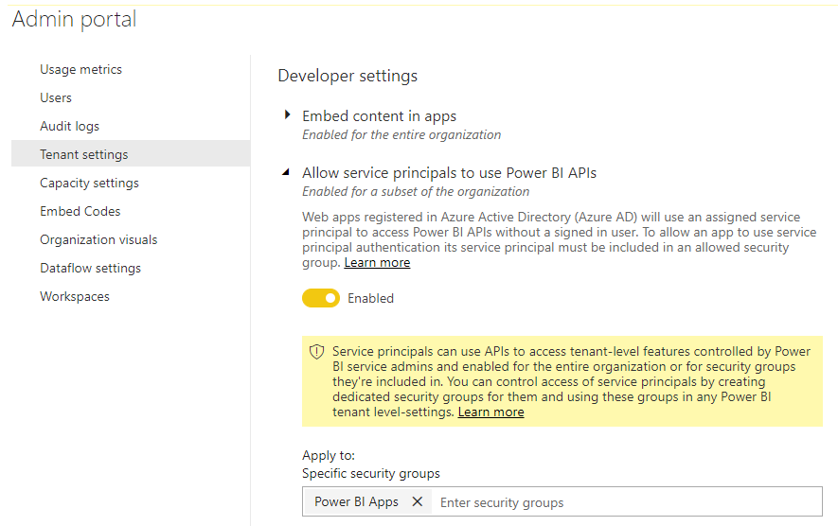
Setting Up for App-Owns-Data – Part 1
Enable Service Principal Access to Power BI Service API
Create an Azure AD security group (e.g. Power BI Apps)
Add group to Power BI Allow service principals to use Power BI APIs

Slide 9
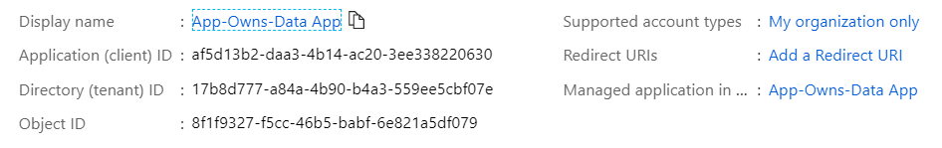
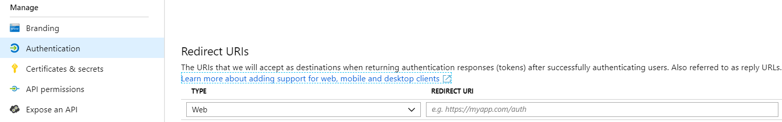
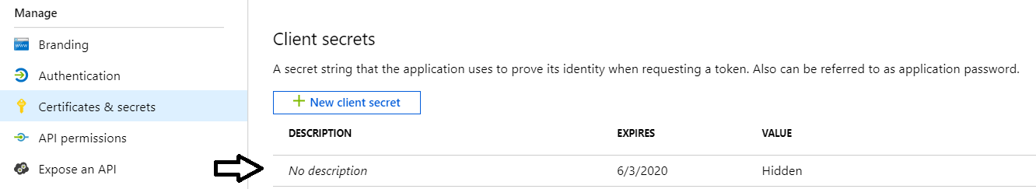
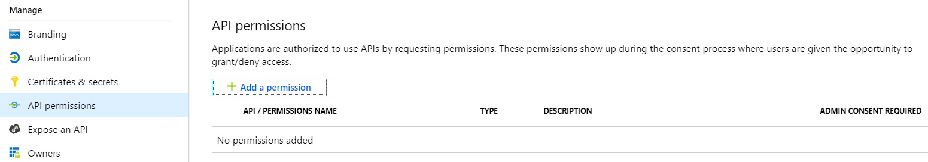
Setting Up for App-Owns-Data – Part 2
Create a confidential client in your Azure AD tenant
Configured as TYPE=Web and no need for a redirect URL
Add a client secret or a client certificate
No need to configure any permissions

Slide 10
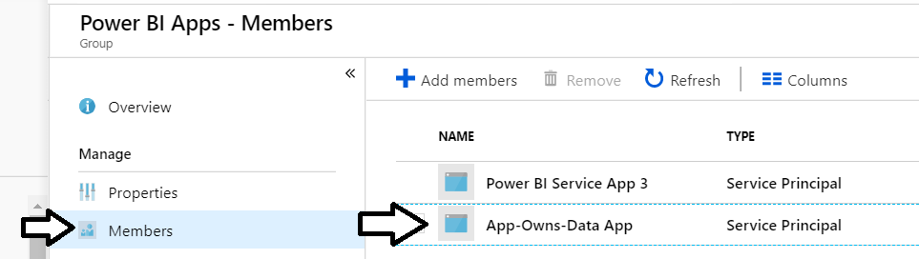
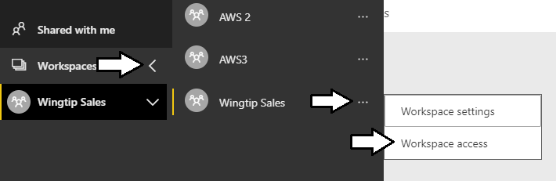
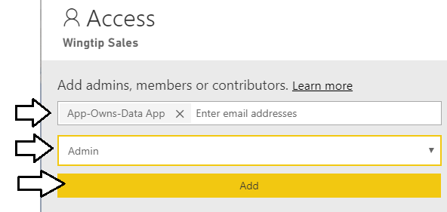
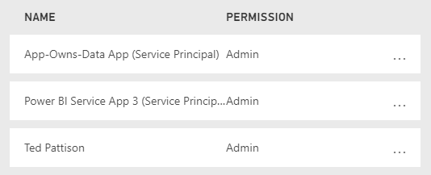
Setting Up for App-Owns-Data – Part 3
Add application's service principal in Power BI Apps security group
Configure application's service principal as workspace admin
Service principal should now be workspace admin

Slide 11
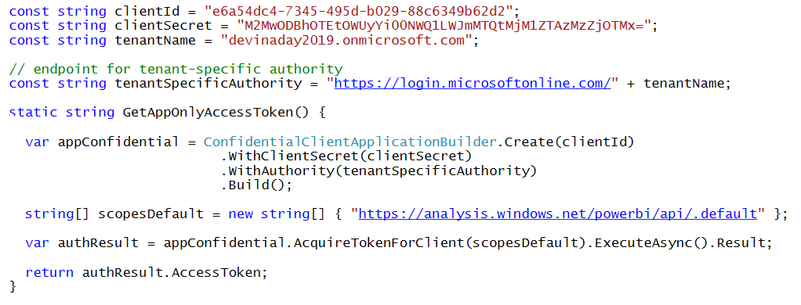
Client Credentials Flow
Client credentials flow used to obtain app-only token
Requires passing app secret (e.g. app password or certificate)
Requires passing tenant-specific endpoint

Slide 12
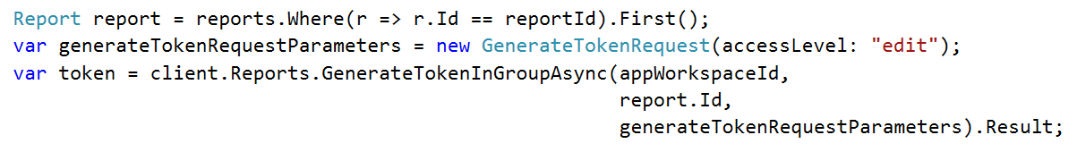
Generating Embed Tokens
You can embed reports using an AAD token, but…
You might want embed resource using more restricted tokens
You might want stay within the bounds of Power BI licensing terms
You generate embed tokens with the Power BI Service API
Each embed token created for one specific resource
Embed token provides restrictions on whether user can view or edit
Embed token can only be generated in dedicated capacity (semi-enforced)
Embed token can be generated to support row-level security (RLS)

Slide 13
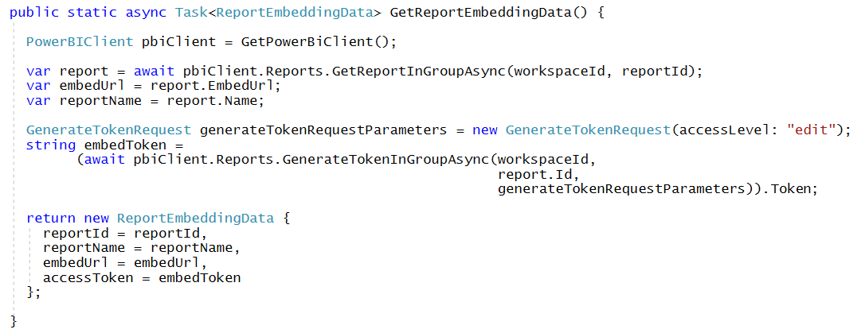
Getting the Data for Report Embedding

Slide 14
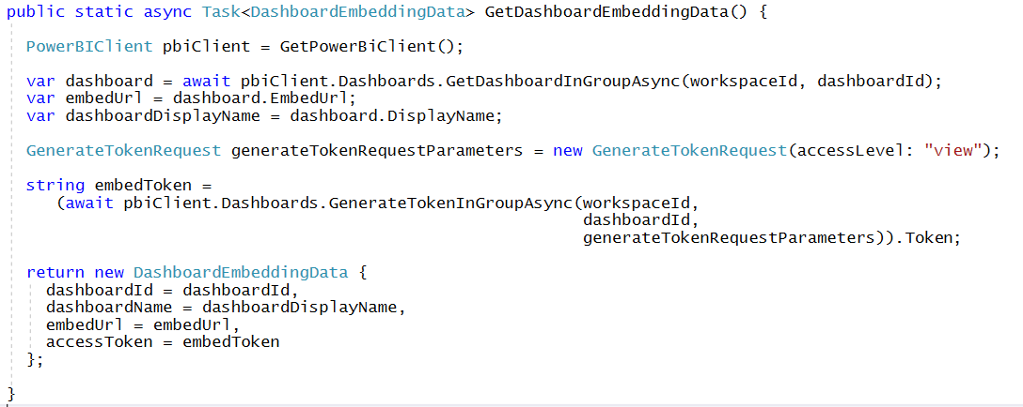
Getting the Data for Dashboard Embedding

Slide 15
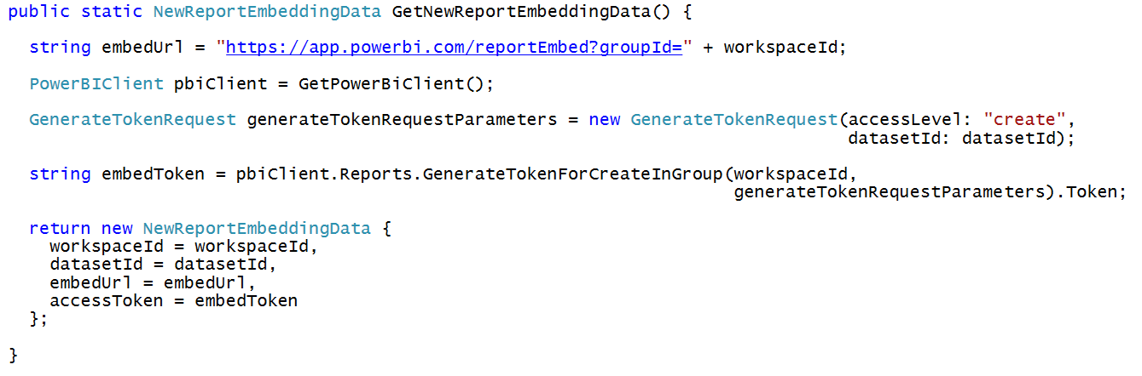
Getting Data for New Report Embedding

Slide 16
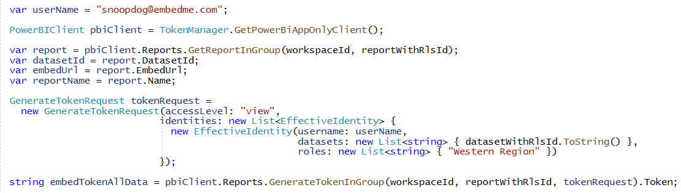
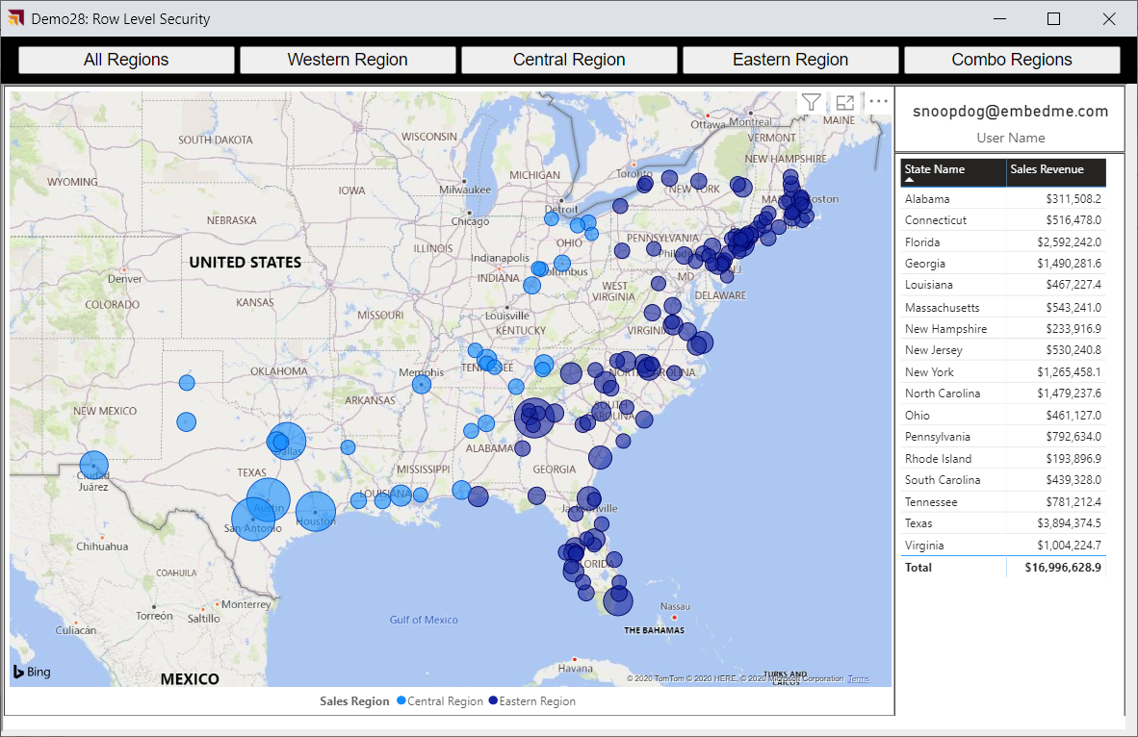
Generating Embed Tokens with EffectiveIdentity

